Slide 1

Opening URL

Slide 2

Reference
sentdex’s Blog and Youtube
Youtube
Code

Slide 3
Open Google

Slide 4
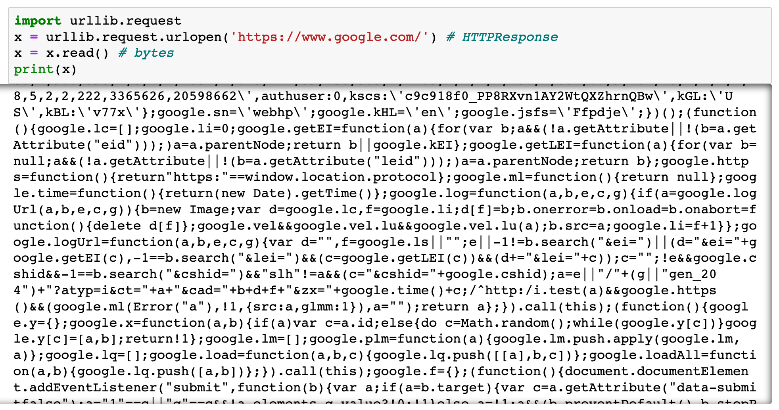

Slide 5
Ask Google

Slide 6
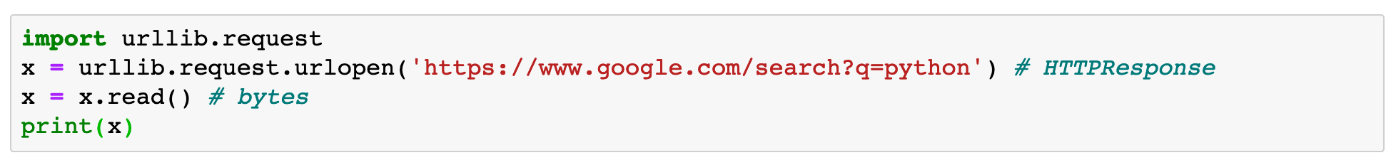

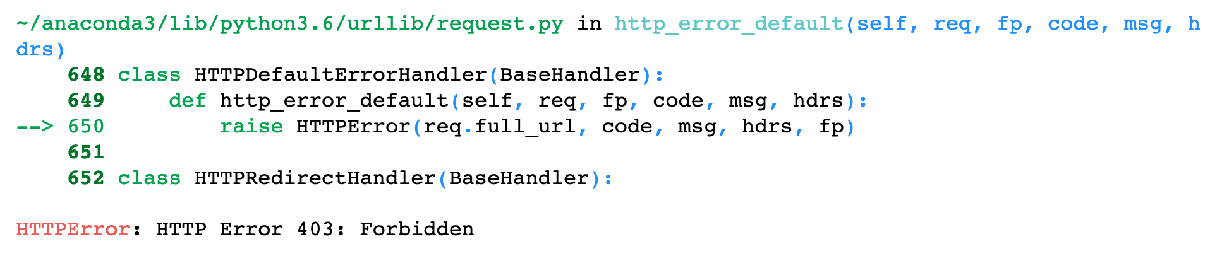

Slide 8
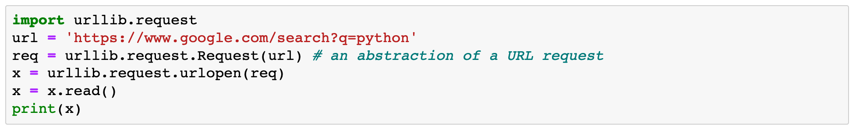
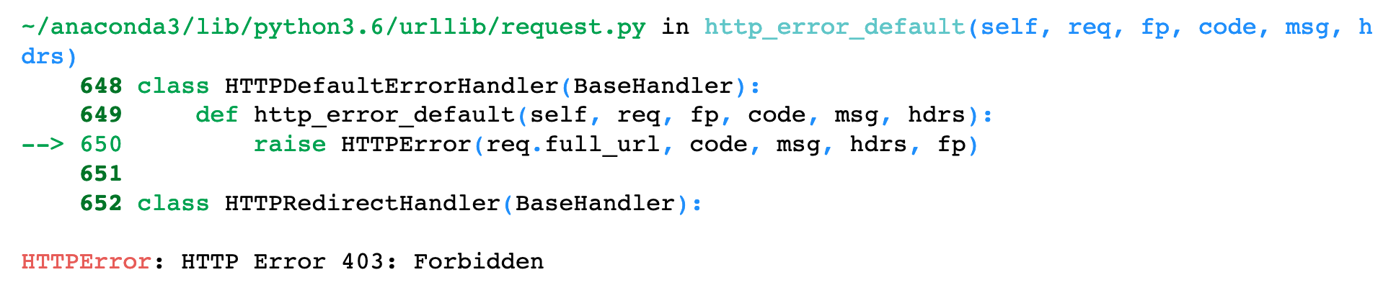

Slide 10
Fool Google

Slide 11
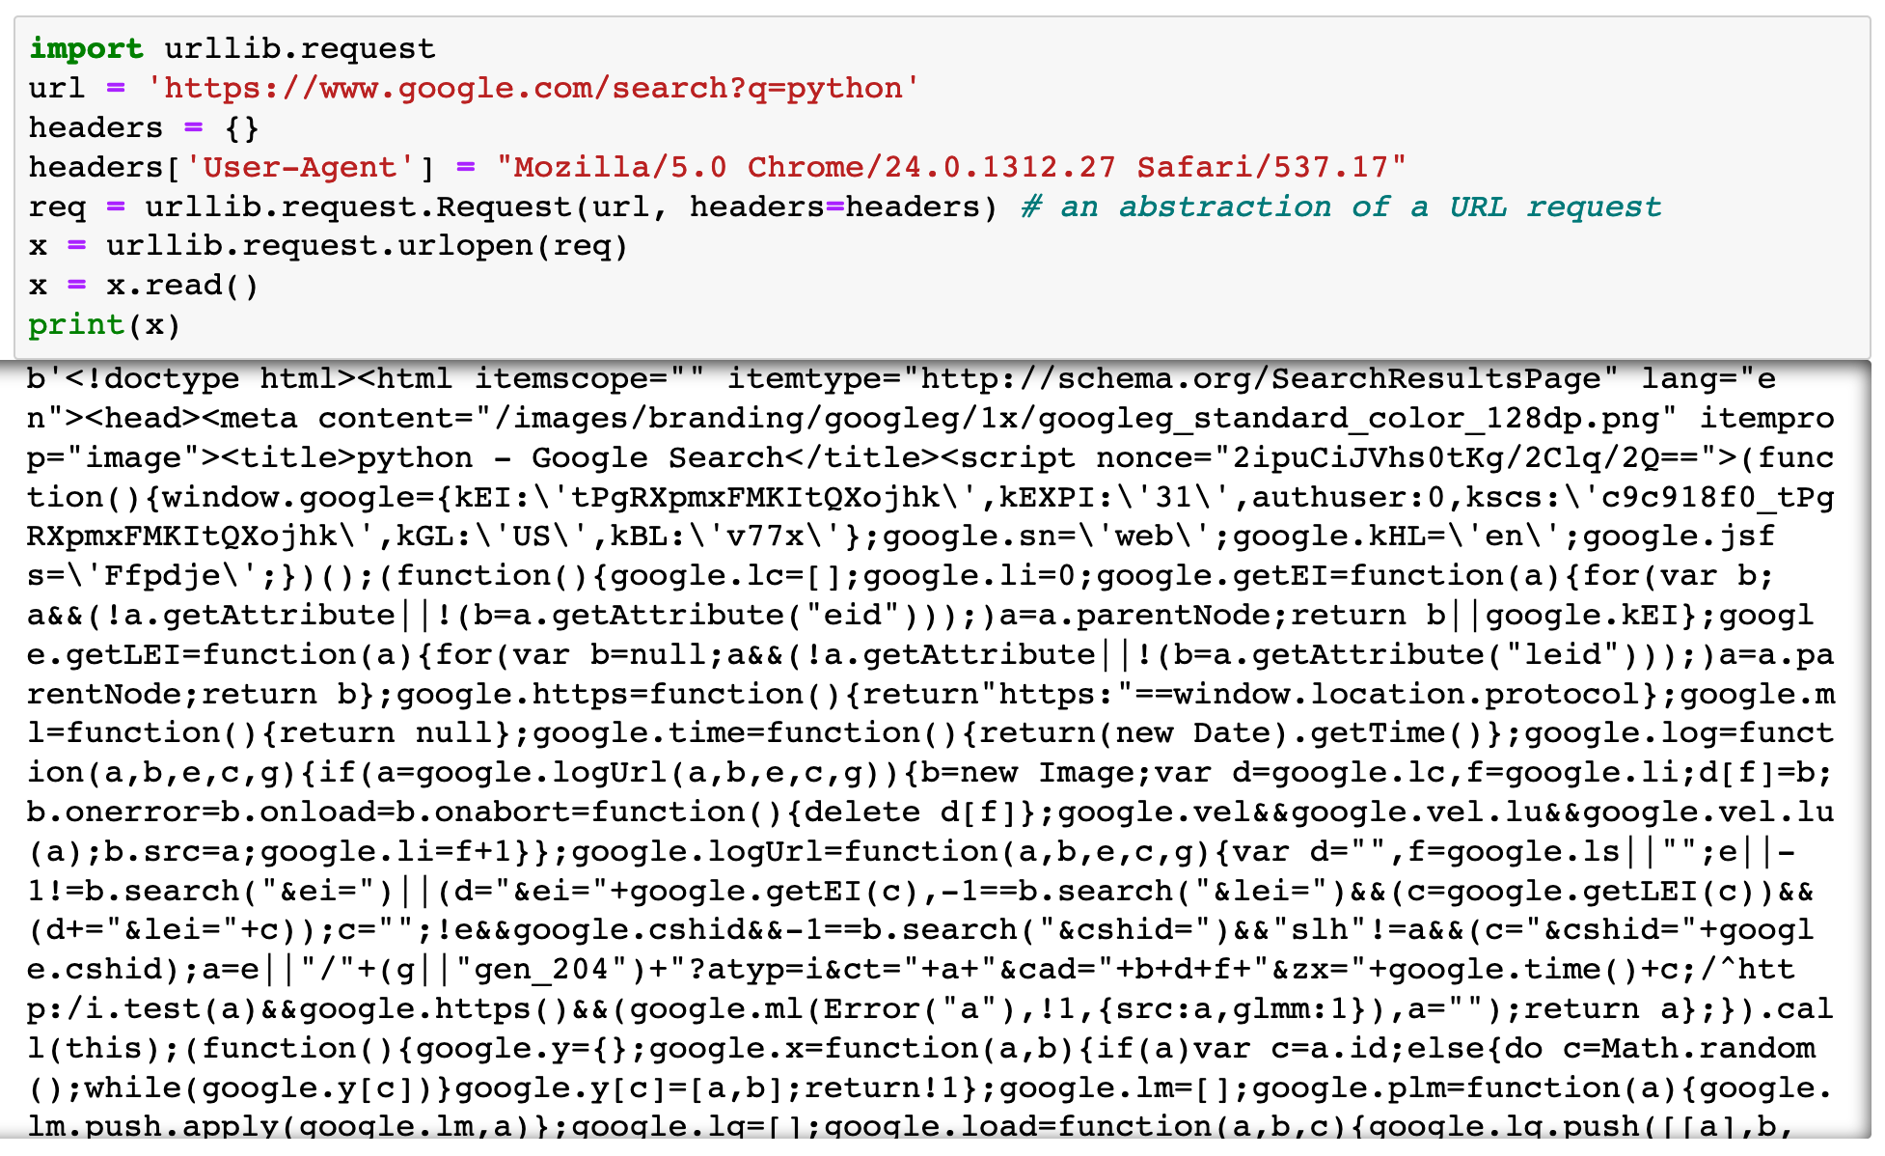

Slide 12
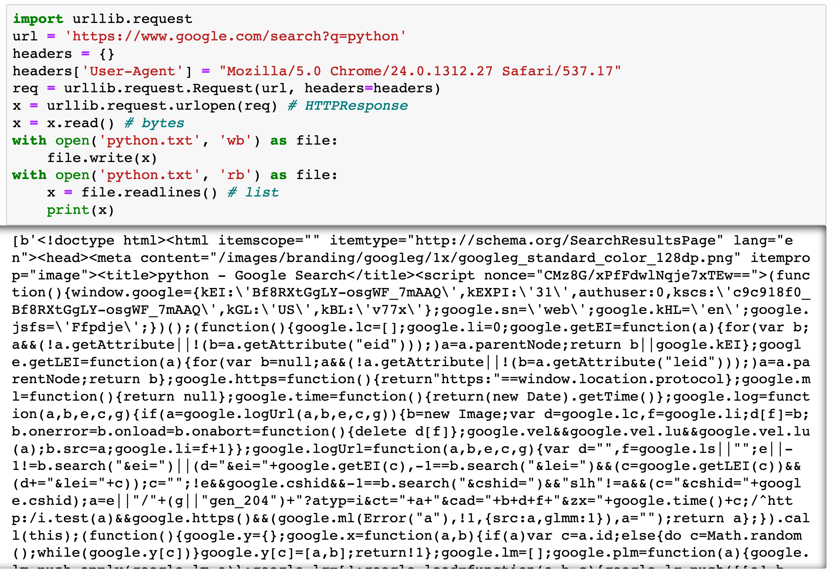

Slide 13
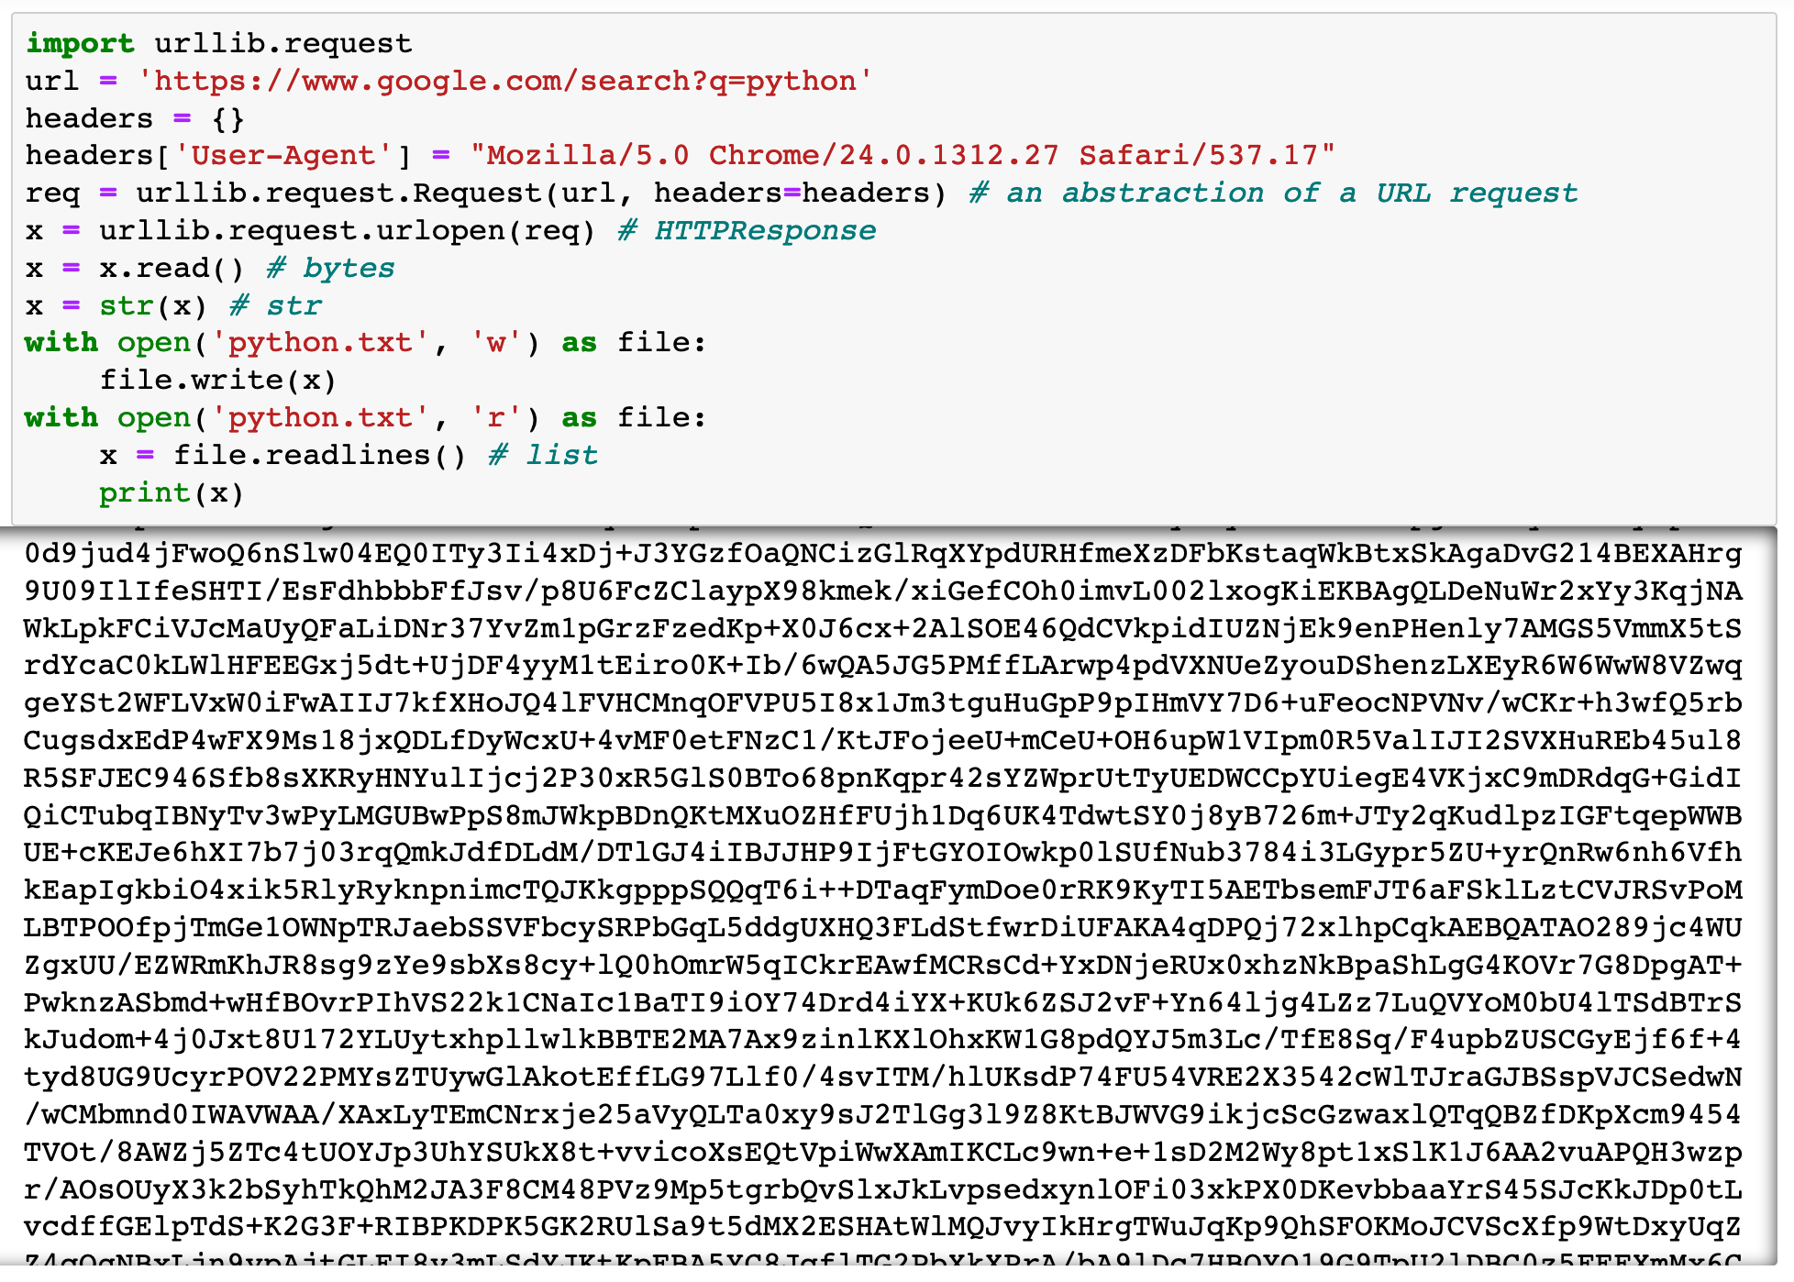

Slide 14
Now
Let’s Play with Code

